Slide 1
Voalte UI/UX
Creating value-added user experience
Notes:
Disclaimer: Part of presentation was removed due to the amount of internal information presented.

Slide 2
Importance of UI/UX
“Unless you can really compete on price you better find another way to differentiate yourself. That other way is design.”
—
Dmitry Fadeyev, Value of Good Design, usabilitypost.com
Notes:
Importance of UI/UX Slide
Summary : As a consumer and product driven company, we should push to deliver exceptional user experience, gain competitive advantage over our competitors, and monetize over value added features. Focusing in user experience will have long lasting effect for us as a company moving forward.
So what exactly can an exceptional UI/UX do for us ? It allows us for….
Ease of new client acquisition:
Reflect the unique and exceptional Voalte experience.
Allowing our app to reflect consistent branding and marketing goals.
Create truly value added features
Voalte is entering this rapid growth stage with a maturing mobile healthcare industry. We will have to find ways to distinguish ourselves,
become the industry leader NOT the follower. (With design being an important aspect of it, and of course engineering , support and other function of the company that follows)
At the end of the day , we want to Increase ROI, for the company with:
Decrease the need for redundant tech support
Increase user satisfaction rate
Measure by the decrease in tech support tickets
Longer and more “active” users in hospital setting
Decrease the amount of training time for end users and the amount of onsite ICs,VMAAs…
Decreasethe deployment cost and decrease deployment time.

Slide 3
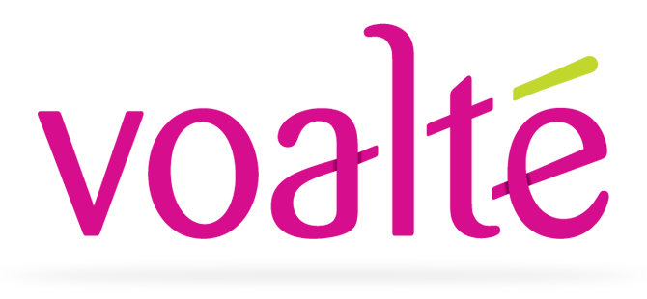
Our Story
“Listening to our customers and developing software that’s life-changing and life-saving is how we roll. From conception of the idea to delivery of our latest product, we focus on our customers every step of the way. In an industry where companies too often settle for being “good enough,” we think you deserve better.”
Notes:
“Good design at the frontend really suggests that everything is in order at the backend, whether or not that is the case.”
The Value of Good Design
There are also plenty of researches conducted that have data that states large number of users assess the credibility of sites and application based on the appeal of the overall visual .
As a reminder, this is what we promised our customers, “we don’t settle for being ‘good enough ’ “

Slide 4

#1 from 10 things we know to be true
Focus on the user and all else will follow.
Notes:
And if I draw some parallels, here’s Google’s number 1 philosophy .
With that we will move on to see how usability is evaluated and how Voalte Platform is doing against these evaluations.

Slide 5
Design & Usability Evaluation Metrics
Design Tricks
Apple’s iOS Human Interface Guidelines
Aesthetic Integrity
Consistency
Direct Manipulation,
Feedback
Metaphors
User Control
Google’s Material Design & Usability
Principle: clear,robust, and specific
Color & Contrast
Sound
Motion
Layout
Writing
Hierarchy & Focus
Implementation
Nielsen’s Usability Heuristics
Visibility of system status
Match between system and the real world
User control and freedom
Consistency & standards
Error prevention
Recognition rather than recall
Flexibility and efficiency of use
Aesthetic and minimalist design
Help users recognize, diagnose, and recover from errors.
Help and Documentation
Notes:
Using Usability Evaluation
Summary : With the importance of UI/UX established, let’s briefly walk over how usability and user experience is evaluated. Human eyes are extremely sensitive , and that’s what makes design hard to grasp.
A lot of people think “UI is just a matter of opinions and colors” .
That’s not exactly true, there are specific ways user experience can be evaluated objectively .
One of the most widely adopted metrics in the industry is the Nielsen’s usability heuristics .
Here you can find specific and objective qualification on if we are delivering good user experience. You can even find these heuristic guidelines being mapped into the two of the most popular client ecosystems . IOS and Android. These guidelines were set up to maintain consistency between different apps within the same ecosystem.
Having this consistency is extremely important in helping users to adopt and familiarize expected user behavior . Can you imagine having users to relearn a new set of rules every time he or she download a new app ? That would be disastrous.
So here you can see how detailed the Nielsen’s usability heuristics are . We do well in most of these evaluations and I’ve bolded some specific points where we could use some attention.
We will go through these in more detail in the next couple slides as we walk through a typical user flow within our Voalte system
Questions?

Slide 6
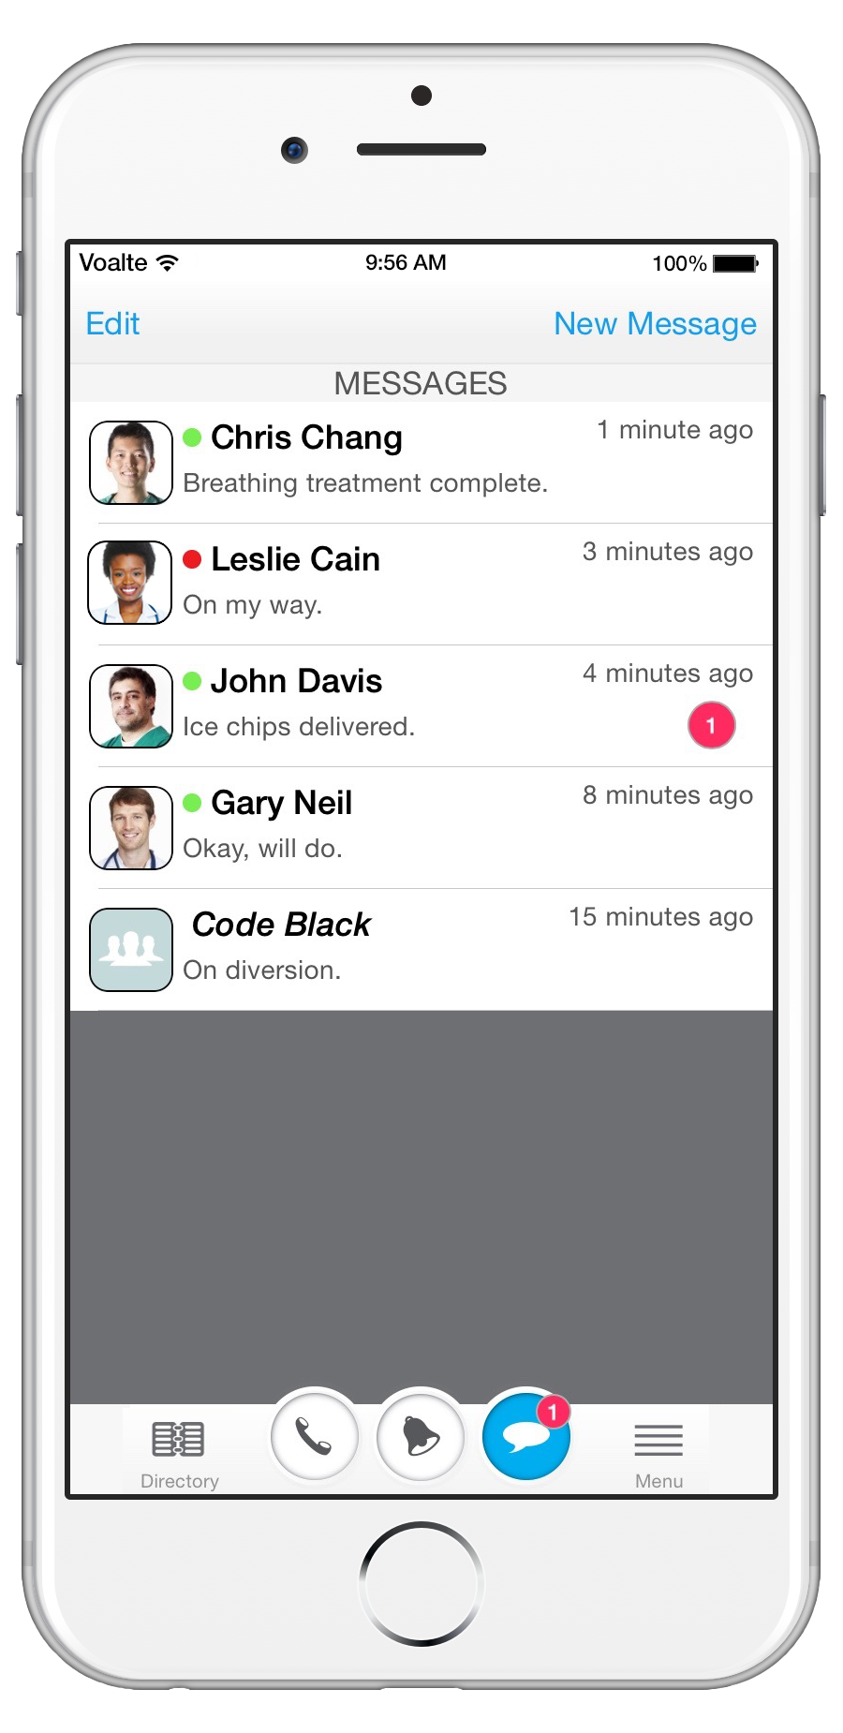
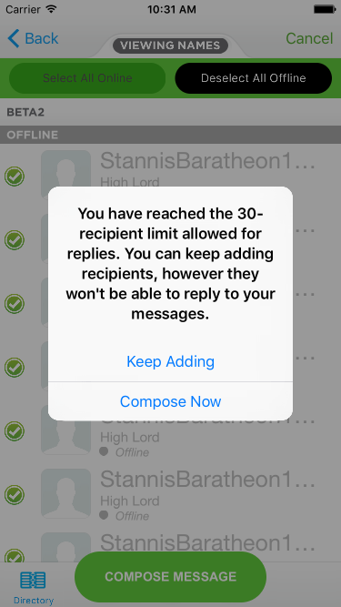
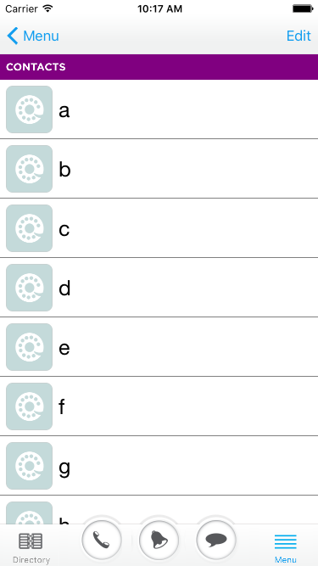
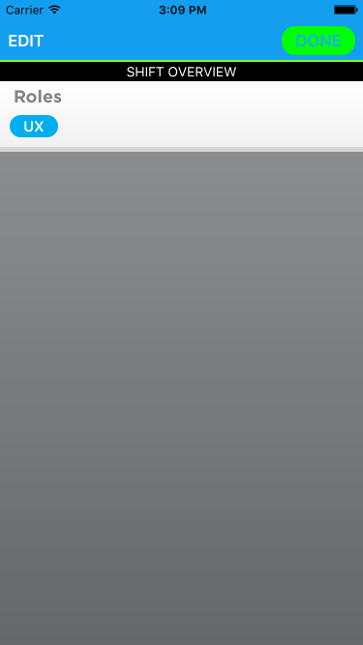
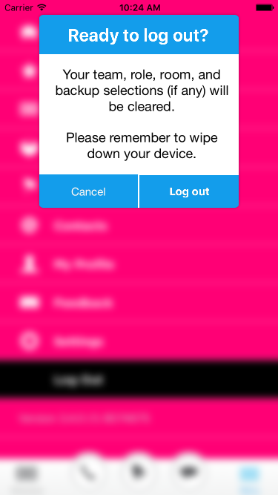
Current User Experience
A typical user-flow
Notes:
Consistency of the overall Voalte System
Summary :
Analyzing Voalte from a higher level overview , our current system is feature rich and densely packaged. However, anyone who has had experience onsite would be able to recall incidents where our end users didn’t realized certain features existed . Leading them into frustration and negative experience with the Voalte system. If you remembered the couple bullets I highlighted a slides back, to improve the current UX , we essentially need to find
1 )Consistency & standards,
bring
2)Aesthetic & minimalist design
Help
3)Users recognize, diagnose, and recover from errors and
Allow
4).Users to recognize an action rather than having them recalled an expected action.
We have a great features, it’s a shame if we don’t see more users actively using them.
Without going into specifics just ye t, and just by looking at this slide right here, you will realize our UI is fairly inconsistent as it deviates and follows iOS standard practices from screen to screen. Our system also contains 5+ colors and different sizes of fronts to convey very specific emphasizes on different screens. Referring back to the usability heuristic evaluations, this is not only distracting and inconsistent , it subconsciously results in extra cognitive load for our users to distinguish from one action to another. Imagine nurses curious about why the color just all the sudden changed, or why certain things aren’t in a certain place. That’s the discrepancy we want to solve.
[off script]
talk about inconsistencies on the screen, and distracting colors.

Slide 7
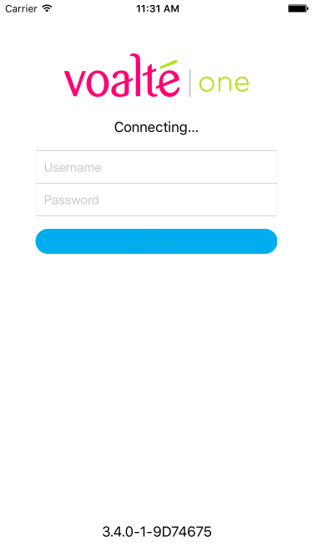
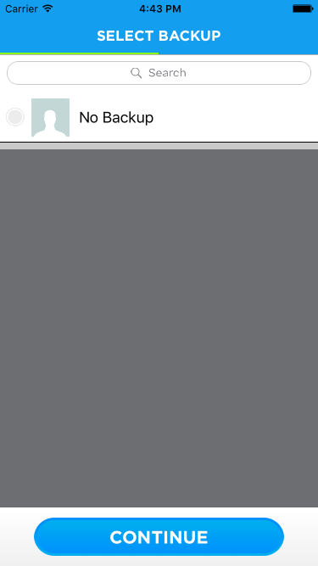
Voalte User Flow - Onboard
Notes:
1.Onboarding (Signing in process)
Summary: Traditionally for consumer facing products(apps), the onboarding process refers to initial app launch where it provides an enduser
training before a user is finally landed inside the system.
Understanding our unique niche of consumers, this might not be completely applicable. However, upon looking at these initial screens, we still have some room for “ design fun ”. We could guide our end user through this signing in process while providing a brief overview of how our app work. (this in the end would leverage for additional trainings needed from our ICs/Support team)
Aside from the educational purpose of this onboarding process, these screens are also golden opportunities to express VOALTE as a brand .
1. Note: Inconsistency in tapping Continue and Done.

Slide 8
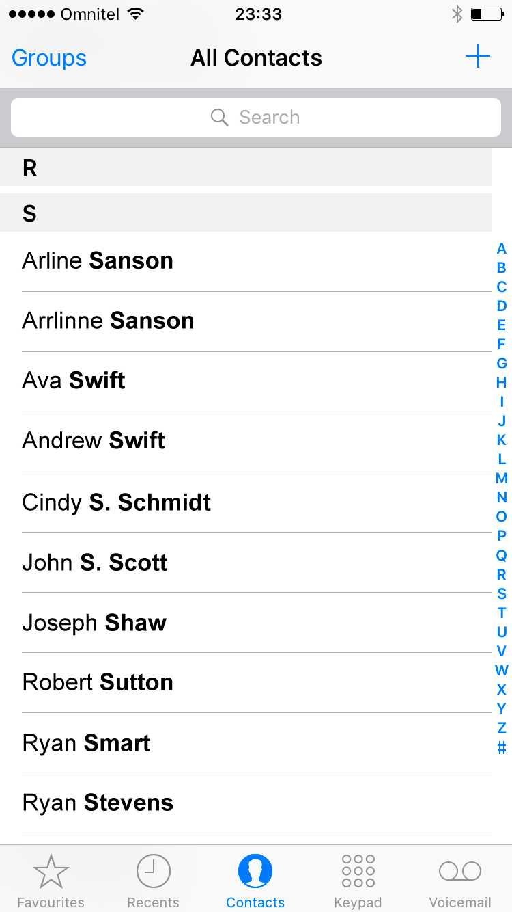
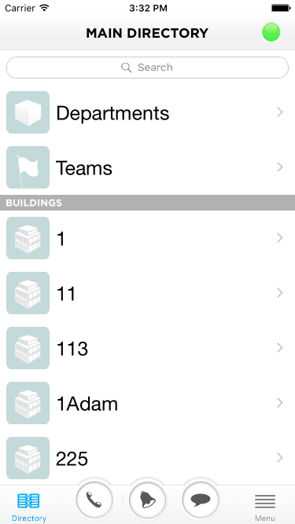
Home/Main Directory View
Notes:
Main Directory View
Summary : This is first screen a user sees after the initial onboarding process. At first glance , this is a screen with large table row sizes and easy to read. If we pull up the default [Contacts] UI from the IOS system , you’d immediately notice the scroll to filter feature that cease to exist in our system. There are also other little things and minor criticisms , but let’s move forward to the core functions of this app so we can see what inconsistencies exist from screen to screen.
1. Default icons doesn’t “pop”/stand out
2. Awkward grey divider.

Slide 9
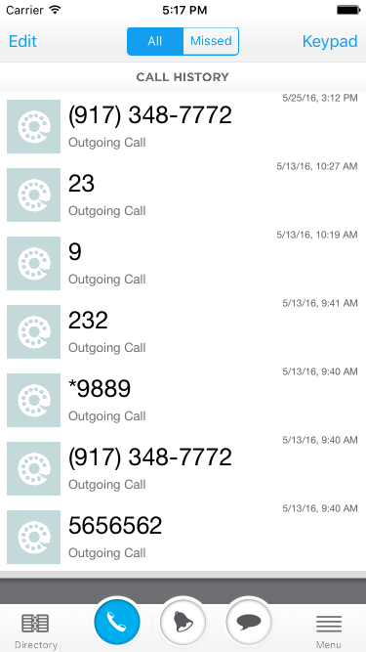
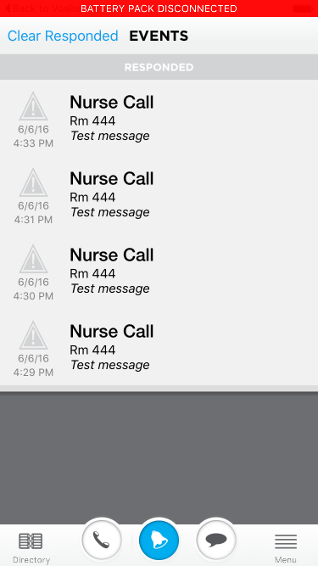
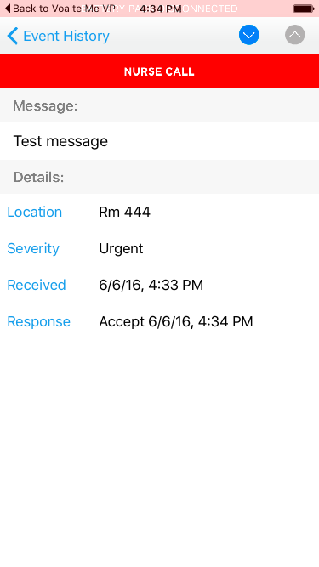
Core Features
Notes:
Alarm/Text/Call NonEmpty Views
Summary: So as a nurse , or hospital staff. I’m finally here in the core features of Voalte. I’m supposedly excited because Voalte is suppose to make my life better with mobile healthcare solution right? However, just from navigating quickly between the core feature screens, you can’t help but feel how the different screens flickers in front of you. You can’t pinpoint what’s exactly “wrong”, but it feels awkward to navigate around.
So let's take some time and analyze what I mean by “ flickering” .
Notice:
1. Differences in Table row sizes due to differences in font size and differences in icon presenting styles.
2. Intruding banners .
3. Difference in the presentation of icons.
a. Inverted colors vs no border design.

Slide 10
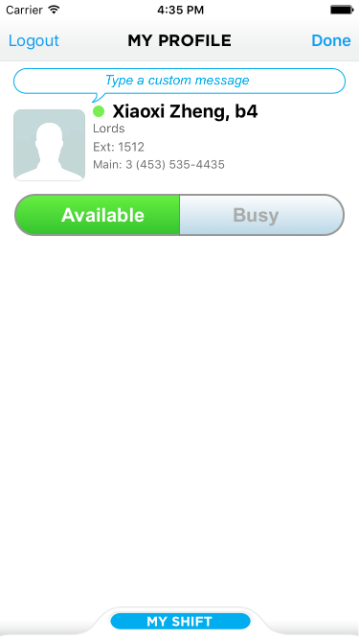
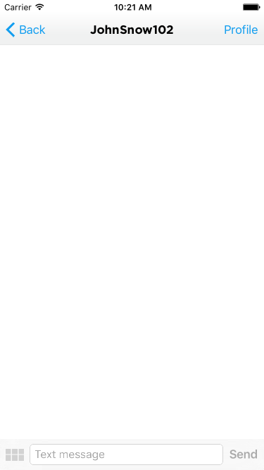
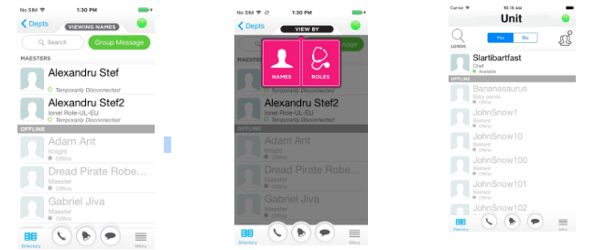
Potentially Unused Features
Notes:
Potentially missed Features
Like I mentioned previously, one of the major criticism for Voalte Platform is that we have a feature rich system, but some of them seem to be “hiding” from the end users. Here you will see a couple examples.
User Profile View
In the user profile screen, I'm expected to know what my role, team, and all the information I inputted during my shift selection process. However, I landed on this page. It has my basic information, now what? We have so much empty space, yet users are still expected to tap on the “my shift” tab. Referring back to the usability heuristics, this requires users to “recall” an action rather than intuitively “recognize” an expected action.
And because we want Voalte to look identical on both ios and Android, this specific gesture(scroll up from below) is almost specific to IOS, which require Android users to learn this expected gesture.
====
Detailed Directory View
Similar to the user profile view, detailed directory view has a similar issue. The viewing by Name/ Role/ Room feature is basically hidden from the user. I think it took me a month myself to “ uncover ” this feature. And it wasn't from “playing around with the app, it was from the code ….
I know I didn't went through any end user trainings but as we go live with bigger hospitals and with more phones, it's almost unavoidable for some users to never receive any training from our ICs. (Ex: Cedars)
===
Messaging View
The messaging interface is fairly straightforward and follows default IOS UI designs. With features like:
1)Sending Priority messages
2)quick messages
It would be interesting to ask end users some opinions about the presentation of these features, and how many of our users opt in just to type the message, instead of routing through “quick messages”.
Q: Do they know what priority messages or the double exclamation points actually do?
With some more research and data analysis , I'm sure ICs and tech support bffs will have a list of features to add that are often missed by users when they first encounter our system.
It would be interesting to see the actual percentage of users actively using these features. (Stress we need in-app analytics implemented!)
With that being said, let’s move forward and see how we can highlight these features with empty states.

Slide 11
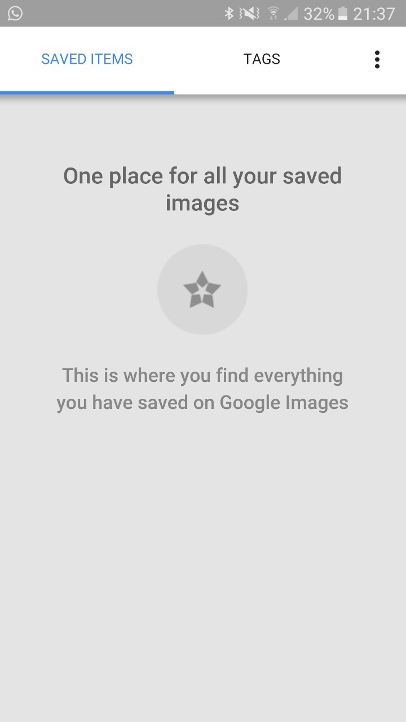
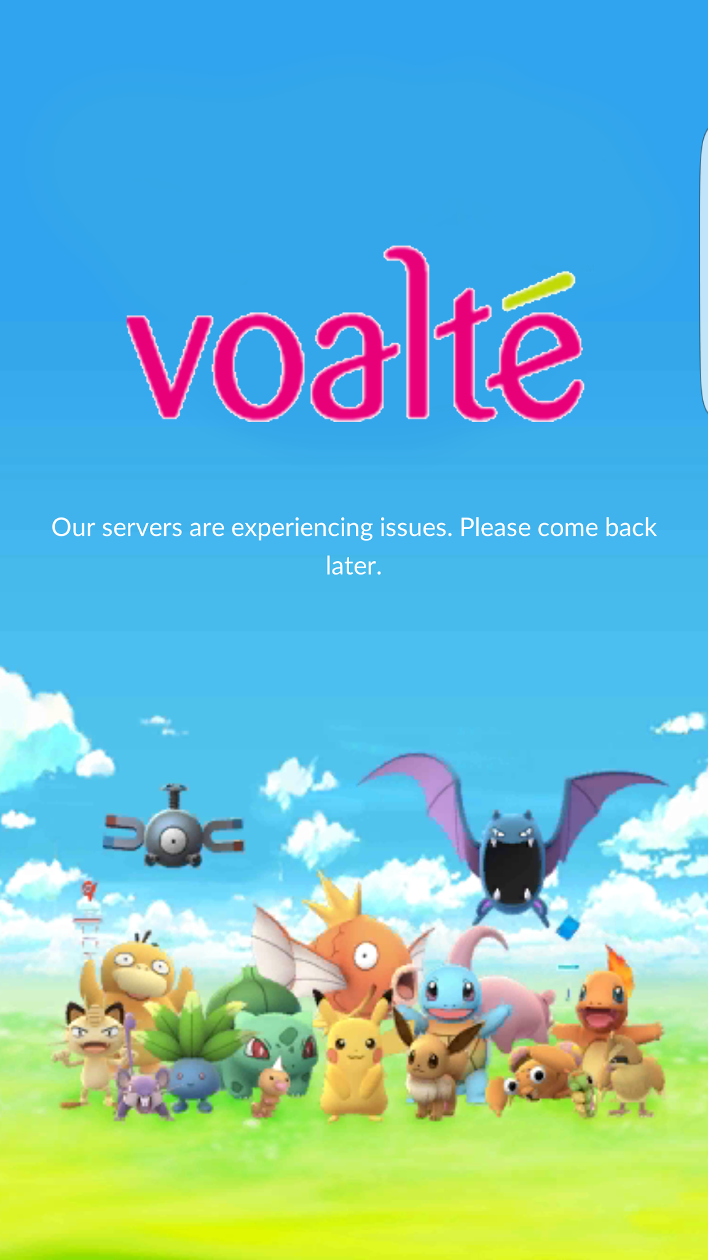
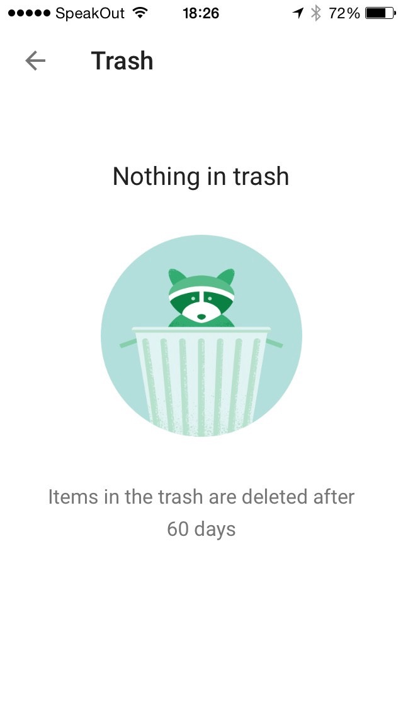
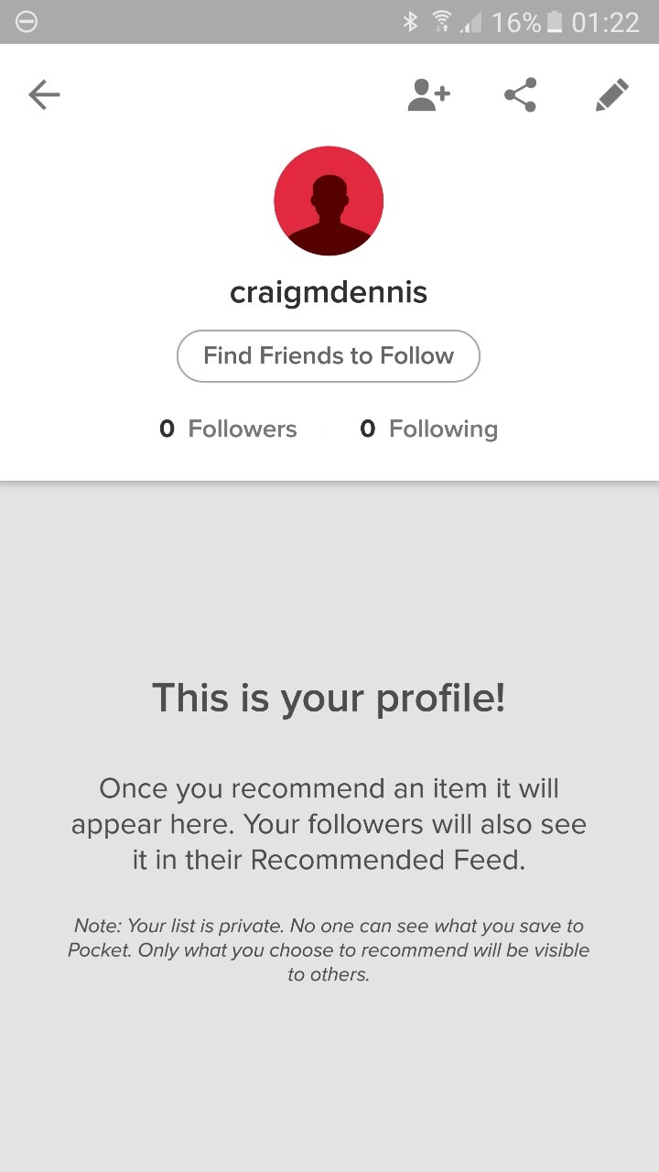
Empty States and Error Prevention
Notes:
Alarm/Text/Call EmptyState Views Slide
Summary: Empty state is probably the most overlooked aspect of ux design , and it could be the most important.
“ A useful empty state tells you what it’s for, why you’re seeing it, and how you can fill it up …. (what, why and how) is the formula for reengaging
your user, but also keep in mind that it’s the bare minimum requirement for an empty state.”
Benjamin Brandall
Consider redesigning our empty states on different screens that tells the user what they should be expecting . It is an extremely helpful for users to learn about our system with these temporary empty screens. On the slide here, you can see some interesting empty state designs. Consider how helpful this would be if it’s applied to a user’s “empty” favorite/contact/message screens?
This will help cope with the low active use rate, and reduce redundant support desk tickets. A well designed app, should be able to explain itself to users. Users should eventually learn how to navigate our system with confident and not have to guess what “Contacts” mean in our system.
Another place a we might want to implement this type of system feedback/documentation is in error messages. Referring back to the usability
evaluation metrics, these feedbacks are an excellent examples of “ helping users recognize, diagnose, and recover from errors.

Slide 12
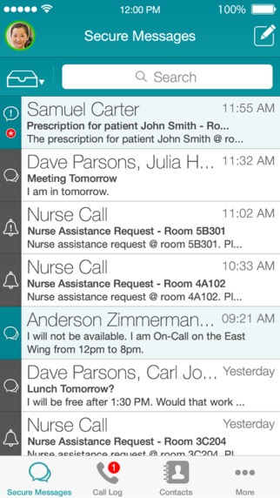
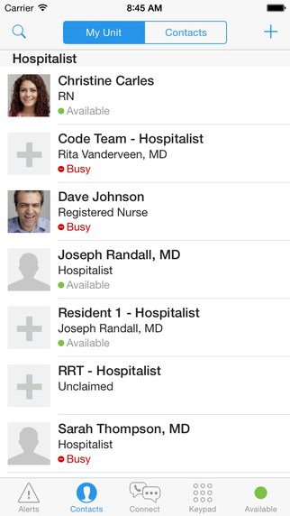
Competitor’s Designs
Vocera Collaboration Suite
Cerner CareAware Connect
Notes:
Competitor’s Design
Summary: Here, I would like to show you briefly what our competitor’s user interface look like. You will see Vocera utilizes its key brand color. Almost immediately you would recognize its Vocera without even needing a logo. On the other hand, you will see Cerner’s fairly simplistic UI that matches highly with the IOS default standard , making this much of a comfortable UI for anyone new to Cerner’s app.
These two sample UIs serve as a reminder that we should make our Rubine RED more prominent in our Voalte system while sustaining IOS standards to make sure end users are comfortable to use.

Slide 13
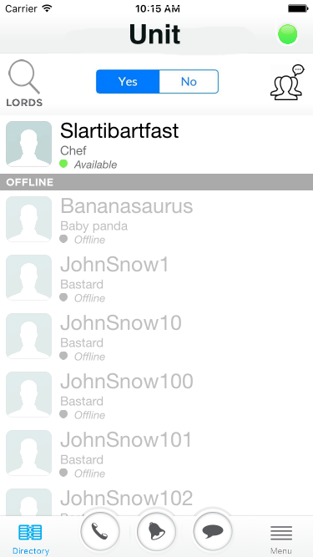
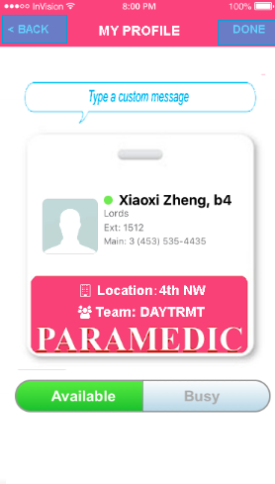
Updated UI/UX
inVision Prototype
Notes:
//Removed hyperlink. Internal information

Slide 14
Looking forward
Creating “Human Goals”
Iterative Design
Problem identification
How do you know it’s a real problem?
What data, anecdotes, etc. lead you to believe this?
Why solve this problem over others?
You have limited resources and time — why apply them to this problem above all else?
Hypothesis
Defining success & roadblocks
Making testable hypothesis
Test, Collect, Observe behaviors
Refine
Notes:
//Cspecific hypothesis was removed from this presentation due to the amount of internal information
Summary: One of the goal for me and this presentation is to encourage managers to incorporate this concept of iterative process design in the deployment process . Generally we have this structure, id problem, hypo ... to ensure the final product we ship has top of class UX .
From what I’ve learned the past couple months here, we are already doing a lot of what this structured out to do, but we could use some emphasis on DESIGN aspect of things instead of pure FEATURE driven releases. This design process could even be independent of the regular deployment process . We could create prototypes and do some initial pilot testing with none of the backend implementation(using tools like inVision, Origami and etc).
Essentially this should be part of the product business review process and final decisions are then converted into the regular triage ticketing system.
//Go in-depth with specific user case scenarios.
Stress analytics!
With that being said, we need a more objective way to analyze our end user experience . We
need to start collecting some data/survey to reflect how nurses and hospital staffs are actually using our app.
What’s the avg. rating a nurse would give after a new app update?
What is the average active rate (in % of all deployed phones)
How long do they spend in the app per shift?
How many calls/alarms/messages gets ignored ?
Consider sending our surveys to those nurses that do not like to use or try to avoid using the Voalte System, ask them what keeps them from using the Voalte phones that are assigned to them.
Note this is different from the Voluntary feedback form we have within our app, we need to be more active (aggressive) on collecting these data. We don't just want bad feedbacks, we want an accurate representation on how our apps are being used on a daily basis. And yes.. There's also strategies in how to prompt for feedbacks with the highest integrity.
[Sample Survey Questions attachment]
Test, Collect, Observe behaviors
So now… we're finally at testing and collecting data to observe user behaviors…
There a lot of third party analytic services that can help us in this process, or we can even start collecting/analyzing our own data from our servers to start. Establishing benchmarks for what identify as a successful “change” is another challenging and lecture itself . But imagine, we could use data to derive potential paid features , potential of paid white labeling our apps for hospitals with strong marketing purposes and etc.
Prioritize Human Center Design.
Instead of simply measuring number of text/calls/alarms received, measure the meaningful exchanges(interactions) within the app. Similar to what
was mentioned in the webinar from UCSF, examples are what are “ actionable alarms ”.
What’s the net positive contribution to patient experience?. [See attached for sample KPIs]
Refine
From either hard data we collected through regular end user usage or through different design specific iterations, we will then finally refine our users’ needs and turn them into triage tickets for developers.
These can be mark as low priority or aesthetic fixes but remember it’s important first step for them to be on the board.

Slide 15
Questions?
Xiaoxi Zheng
- iOS Engineering Intern

Slide 16


